Slide 1
BUSQOM 1080 Supervised Learning II
Fall 2020
Lecture 22
Professor: Michael Hamilton

Slide 2
Lecture Summary
Today: More on supervised learning
Linear decision plane approach to Supervised Learning. [5 Mins]
Support Vector Machine Classifier [10 Mins]
Cross validation for fitting the parameters of the method [10 Mins]

Slide 3
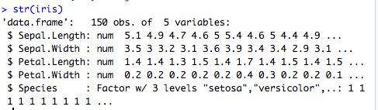
Data for lecture
Let’s stick with the native iris dataset in R
data = iris

Slide 4
Recap: Introduction to Sup. Learning
Problem: Given a training set of labelled observations, want to be able to predict the labels of new observations in the test set
Example: In iris dataset, given observations of flowers belonging to Setosa, Versicolor, and Virginica. Given a new observation of a flower, can we classify it’s species?

Slide 5
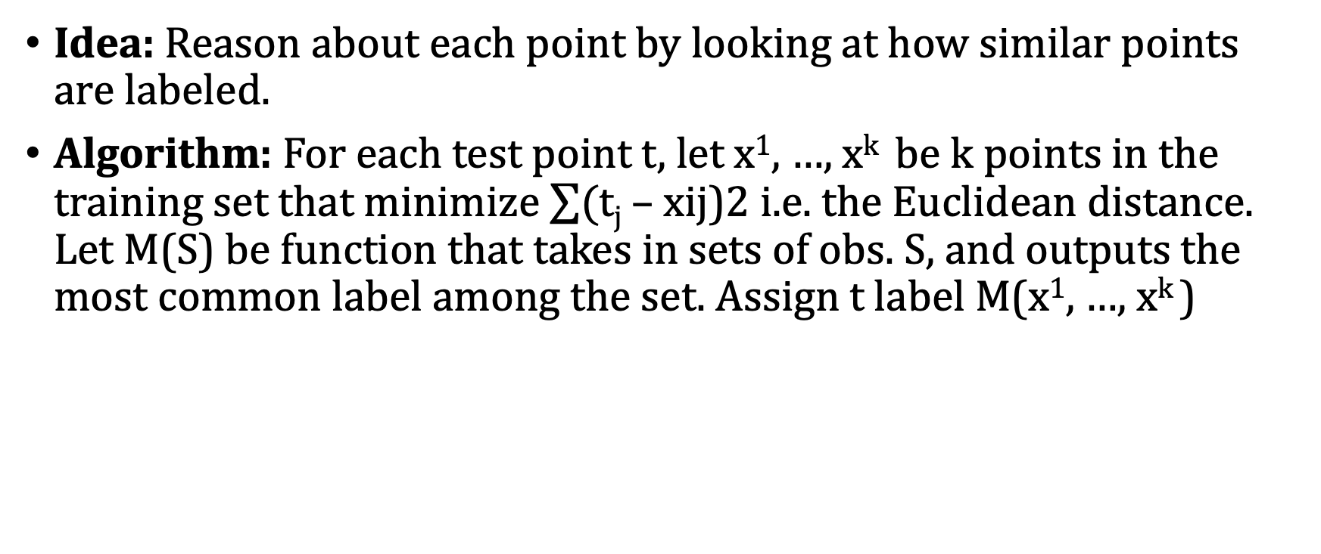
Recap: K Nearest Neighbors
Idea: Reason about each point by looking at how similar points are labeled.
Algorithm: For each test point t, let x¹, …, x^{k} be k points in the training set that minimize $\sum{(\text{t}\text{j} \text{–} \text{xij}\text{)2 }}$i.e. the Euclidean distance. Let M(S) be function that takes in sets of obs. S, and outputs the most common label among the set. Assign t label M(x¹, …, x^{k} )

Slide 6
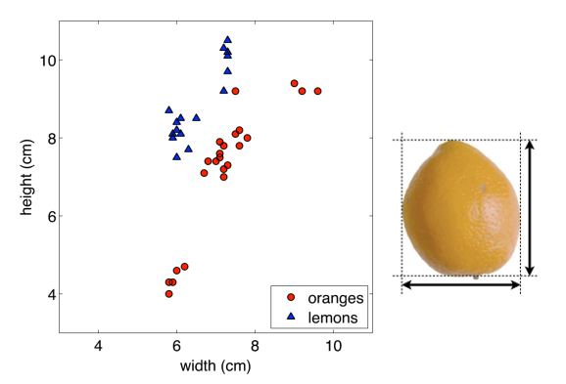
Example: Oranges and Lemons
t’s four nearest neighbors are:
Majority label is Lemon
Goal: Classify new point as orange or lemon.
Algo: Examine neighbors, classify point as major label
t

Slide 7
Linear Decision Planes
K Nearest Neighbors can’t easily pick up on structure in the data.
For this new test point, of it’s three nearest neighbors, two are blue and one is red. But clearly it should be classified as red…

Slide 8
Linear Decision Planes
Idea: Find separating hyperplanes (lines) of the data
New points are classified as red if they fall to the left of the line. Otherwise they are classified as blue

Slide 9
Linear Decision Planes
Idea: Find separating hyperplanes (lines) of the data
How do we find the best separating line?

Slide 10
Linear Decision Planes
Idea: Find separating hyperplanes (lines) of the data
Further, what do we do when no plane can separate all the data?

Slide 11
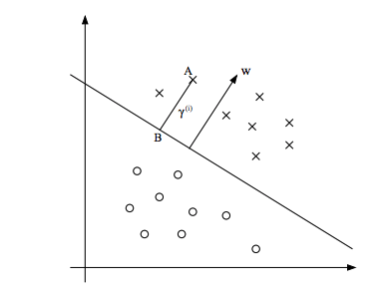
Support Vector Machine
Idea: Try to correctly label as many as possible by minimizing a function to classify points by drawing decision plane through the data.
The best line is the one that ”splits the middle” between points in space.
By splitting middle, we mean the line maximizes the distance between the decision plane and the correctly classified points
If a line correctly labels all points, we call the data linearly separable

Slide 12
Support Vector Machine vs Regression
Note in regression, we were trying to find a line that minimized the sum of the distances from the points. SVM essentially does the opposite, it tries to find the line that maximizes the distance of each correctly classified point from the line.

Slide 13
Support Vector Machine in R
Lets try and classify setosa flowers vs virginica flowers.
>install.packages("e1071")
>library(e1071)
> data = iris[iris$Species %in% c("setosa", "virginica"),]
> shuffled.data = data[sample(length(data[,1])),]
> model = svm(Species ~ Petal.Length + Petal.Width, kernel = "linear", data = shuffled.data[1:70,])
> predicted.labels = predict(model, shuffled.data[71:100,3:4])

Slide 14
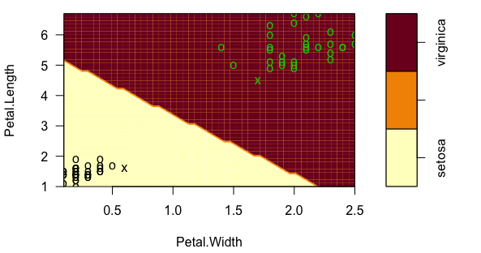
Support Vector Machine in R
> model = svm(Species ~ Petal.Length + Petal.Width, kernel = "linear", data = shuffled.data[1:70,])
Tells R to learn a linear decision plane
Linear Equation just like in regression
Testing DataFrame
> plot(model, shuffled.data[1:70,], Petal.Length ~ Petal.Width)

Slide 15
Support Vector Machine in R
We don’t have to learn lines, there are support vector curves that can better separate data.
Example: Quadratic Decision Boundary

Slide 16
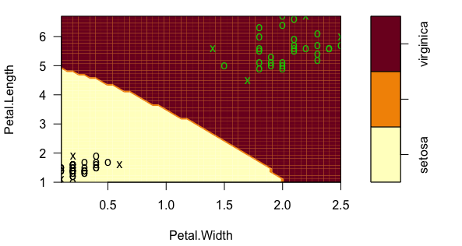
Nonlinear Support Vector Machine in R
> model = svm(Species ~ Petal.Length + Petal.Width, kernel = ”radial", data = shuffled.data[1:70,])
> plot(model, shuffled.data[1:70,], Petal.Length ~ Petal.Width)
Other kernels: “sigmoid”, “polynomial”

Slide 17
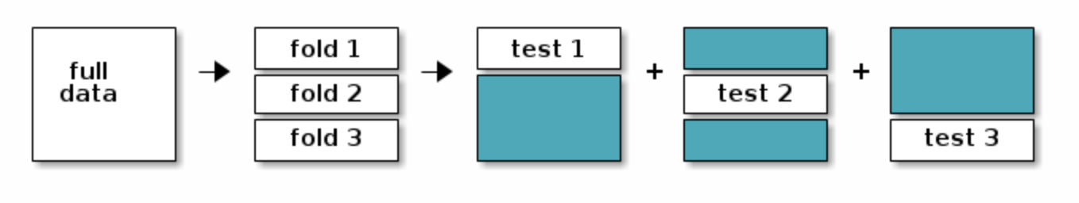
K Fold Cross Validation
Problem: Given a training set of labelled observations, we want to fit the parameters of our model in a way that is generalizable
We just use the given training set, it’s possible there is special structure in the training set that biases us to learn parameters that over fit that special structure.
Idea: Break up training data into pieces, learn model parameters by averaging over all the ways we slice up the training data.

Slide 18
K Fold Cross Validation
Cross Validation is a technique for learning parameters generalizably. Each observation in the data sample is assigned to an individual group and stays in that group for the duration of the procedure. This means that each sample is given the opportunity to be used in the hold out set 1 time and used to train the model k-1 times.
Steps:
Shuffle the dataset randomly.
Split the dataset into k groups
For each unique group:
Take the group as a hold out or test data set
Take the remaining groups as a training data set
Fit a model on the training set and evaluate it on the test set
Retain the evaluation score and discard the model
Summarize the skill of the model using the sample of model evaluation scores

Slide 19
K Fold Cross Validation
Going back to kNN for a moment: Suppose our training set was 100 random observations and we wanted to learn how good a choice of k was.
Fix some number of neighbors to consider (k =3 maybe)
Break training set into five groups of 20 (5-Fold Cross Validation)
Round 1: Training set equals the first 4 groups of 80 obs, test set equals last group of 20 obs.
Check all k, average and save prediction accuracy for this partition of the data
Repeat!
After 5 (since it’s 5-Fold) rounds, average the prediction accuracies for using 3 neighbors and treat that as the generalizable prediction of that choice of neighbors considered.

Slide 20
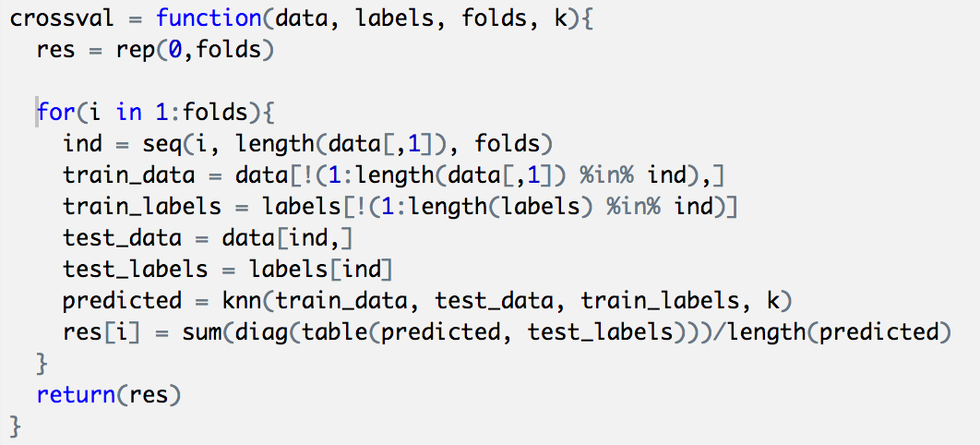
K Fold Cross Validation in R (no packages)

Slide 21
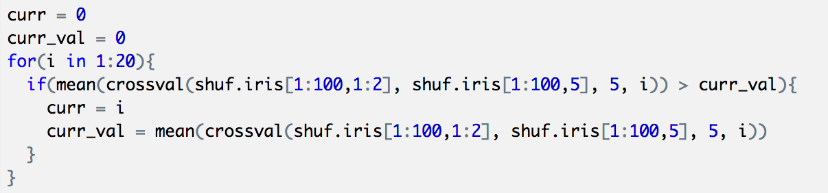
K Fold Cross Validation in R
Let’s find the best k <20 using our brand new crossval() function

Slide 22
Final Thoughts on Supervised Learning
We saw three methodologies: Logistic Regression, kNN, and SVM.
There are many many more ways to do classification, the most prominent of which is using Neural Nets (NN)! Learning how to train and use a Neural Net would be something very nice to try out on your final project!
When doing classification and choosing your methodology, don’t be afraid to try out a whole bunch and keep what works! Different methods work for different problems, it’s fine to experiment until you find a method that works well on your data!

